Slide 1
Utility Rate Increase Proposal
Due to the rising cost of operation the Village of North Lewisburg Council is proposing a water/ Sewer rate increase.
The following slides will show:
Historic rates
Current and estimated Monthly Costs Analysis
Water/ Sewer Repairs and costs
Current Water Line Composite
Cost to upgrade water and sewer lines and improve end point water quality
Proposed rate increase

Slide 2
HISTORY
1948 Flat rate $2.50
1973 Flat rate $48.00
2008 Base 3,000 gal/ month $60.00
Next 3,000 $59.22
Over 6,000 gal $.02/ gallon

Slide 3
*Averaged over the year.

Slide 4
*Averaged over the year.

Slide 5
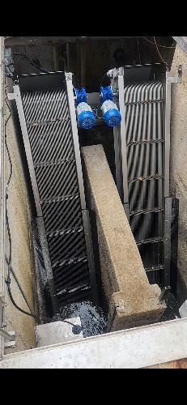
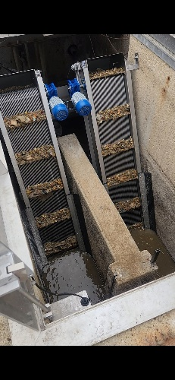
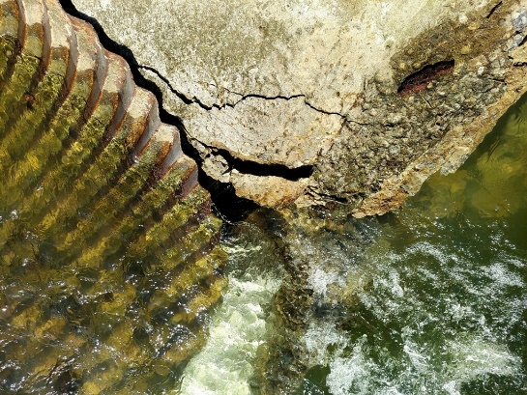
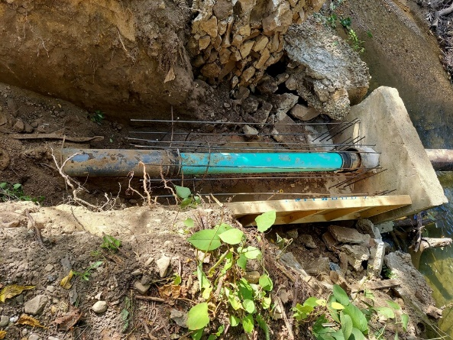
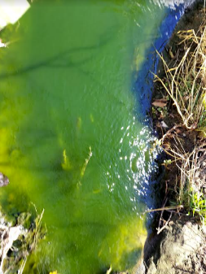
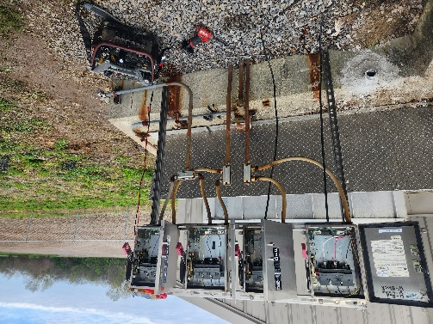
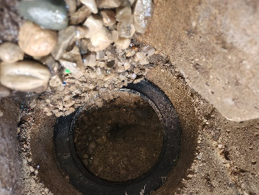
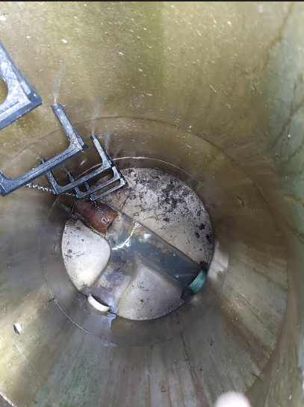
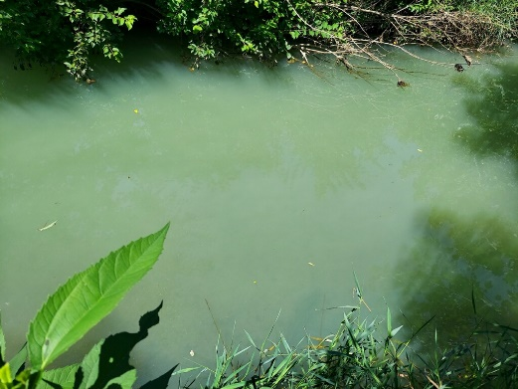
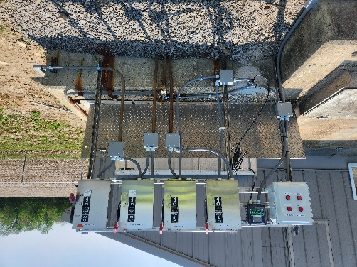
2022-2023 Sewer Repairs
Hazmat Clean up- $41,000.00
UV Lights- $75,000.00
Muffin Monster- $28,000.00
Blower and Motors- $34,000.00
Update Electrical- $10,000.00
MBR Pumps/ Motors- $14,050.00
Fine Screens- $130,000.00
Effluent and Influent Samplers- $6,305.00
Sewer Camera- $16,500.00
Chemical Storage Containment- $10,000.00
SCADA Remote Access- (TBD)
IN HOUSE REPAIRS
Main Break at Spain’s Creek
Building repairs
Lagoon clean up
Membrane Cleaning
Inflow and Infiltration
Spain’s Creek culvert at Sewer plant entrance
Fine Screen Before and After
Sewer Main Repair over Spain’s Creek
Lagoon cleaned up
Fine Screen Panel Before and After
Sewer Lagoon Overflow
Full Open Sewer Manhole

Slide 6
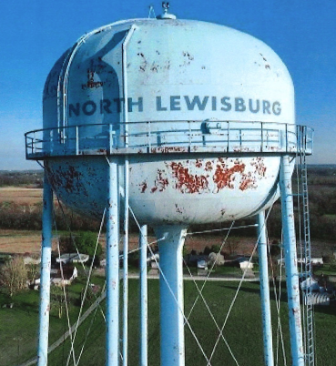
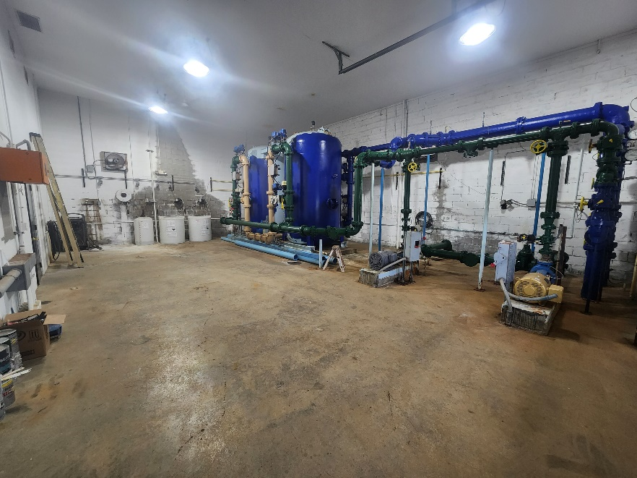
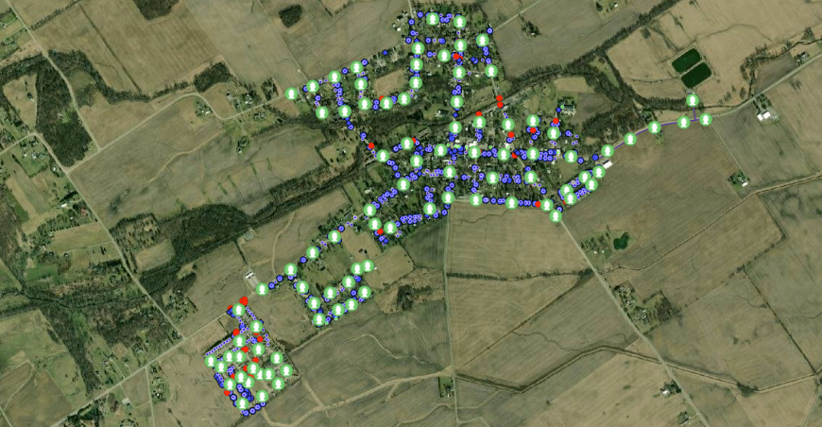
2022-2023 Water Repairs
Water Meter Install- $113,000.00
508 Of 740 will be replaced with Mueller
Currently 67% of meters are working
244 still need to be replaced
Well Pump 1 Replacement- $22,000.00
Aeration System Repair- $175,000.00
Well Inspections- $6,000.00
Well Cleaning- $40,000.00
3rd Well- $80,000.00
2 Water Towers Clean, Paint, Inspections- $800,000.00
Paid over 7 year agreement
GIS Mapping- $7,000.00
Well Decking Repair- $1,000.00
High Efficiency Dehumidifier- $3,500.00
Abandon Low Quality Well- $7,050.00
PRV Valve Upgrade- $43,000.00
West Well Leaking Valve- TBD
West Water Tower to be painted
GIS Mapping
Repainted Water Plant

Slide 7
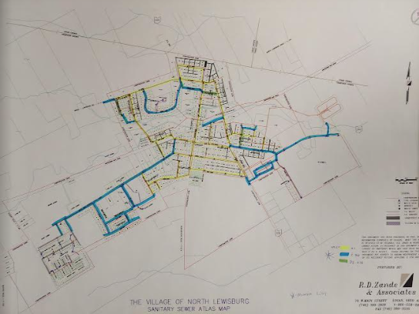
Water/ Sewer Lines
Yellow Lines-
1940/ 1950s Concrete Composite Plumbing
*Causes mineral deposits in water over time
Blue Lines-
New PVC Lines

Slide 8
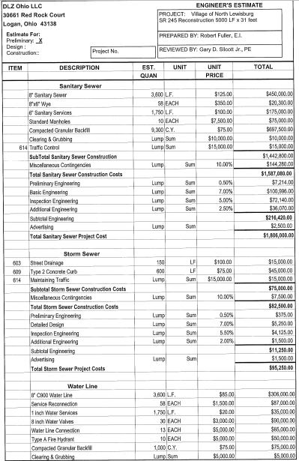
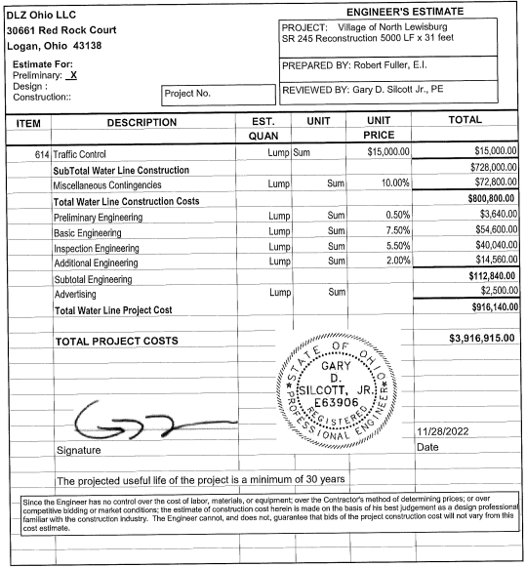
East State Route 245
Water, Sewer, Curbs, Gutter, Storm, and Street

Slide 9
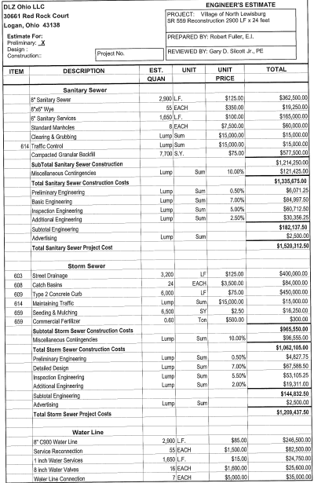
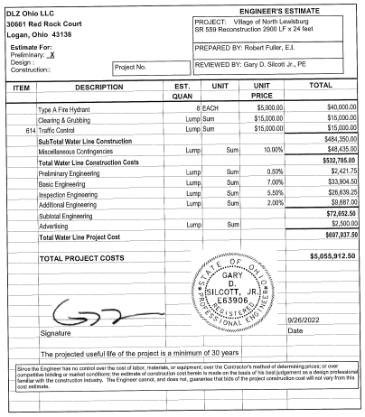
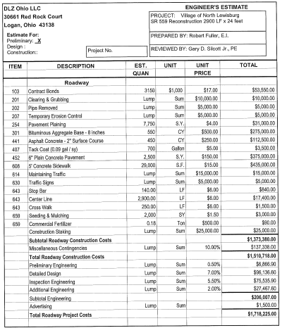
North State Route 559
Water, Sewer, Curbs, Gutter, Storm, and Street

Slide 10
BASE RATE Total Cost Water Sewer
Current Rate $60.00 $25.75 $34.25
2023 New Base Rate $65.00 $27.30 $37.70
2024 5% Increase $68.25 $28.66 $39.59
4% Increase $70.98 $29.81 $41.17
2026 3% Increase $73.11 $30.71 $42.40
2027 Rates will be reviewed again

